Slide 1
Proactive Risk Management
Part 1: Risk Identification & Analysis
Del Brady
DRM Loss Control Manager
April 15, 2026
Notes:
Part 1 of a 3-part series about Proactive Risk Management.
Part 1 – Risk Identification & Analysis (April)
Part 2 – Risk Mitigation & Risk Tolerance (May)
Part 3 – Root Cause Analysis (June)

Slide 2

Risk Identification & Analysis – Why?
Safety for our employees and patrons/customers
Reduce tax dollars spent on claims
Shift from reactive to proactive
Notes:
Safety for our employees and patrons/customers – nothing more precious than a human life. Consider a child getting injured or killed. Consider an employee who has a life-debilitating workplace injury. Consider a patron who arrives for services or recreation and can’t receive those, or worse yet, a happy day is turned into a nightmare by injury or death.
Reduce tax dollars spent on paying for claims – imagine if instead those millions were invested in FTEs, equipment/supplies, educational programs, etc.
Sometimes it might feel like you’re running from one fire to the next. Unfortunately, this may be the nature of risk management in a large organization with a very small team. But we’re going to cover a few strategies to help shift from reactive risk management to proactive risk management, so that you can prevent at least some of those “fires” before they start.

Slide 3
Strategic Workload Analysis
Are you spending your time and efforts strategically?
URGENT
NOT URGENT
Emergencies Project deadlines Last-minute tasks | Prevention Strategic planning Skills development
Some phone calls Some emails Some meetings | Busy work Escape activities Low-impact tasks
HIGH VALUE
LOW VALUE
Notes:
In risk management, it’s easy to get overwhelmed with managing risks in a lot of different areas at once. For example, our school district risk managers may be dealing with playground safety one minute, then receive a call about an employee injury the next, and then later in the day receive news of an HVAC breakdown. As risk managers over large organizations, we get pulled in a lot of different directions.
Because of this, I’ve found it helpful to occasionally pause and strategically analyze where I’m spending my time and effort by using this matrix. Then, as tasks come up or when I’m pulled in a certain direction, I think about which quadrant of the matrix it puts me into. For example, YELLOW square = HVAC break down; GREEN square = analyzing claims data to identify high risk areas; BLUE square = scheduling phone call from your family doctor; RED square = redecorating office space.
Each square has a purpose, this is just a model to help be strategic about work tasks.

Slide 4
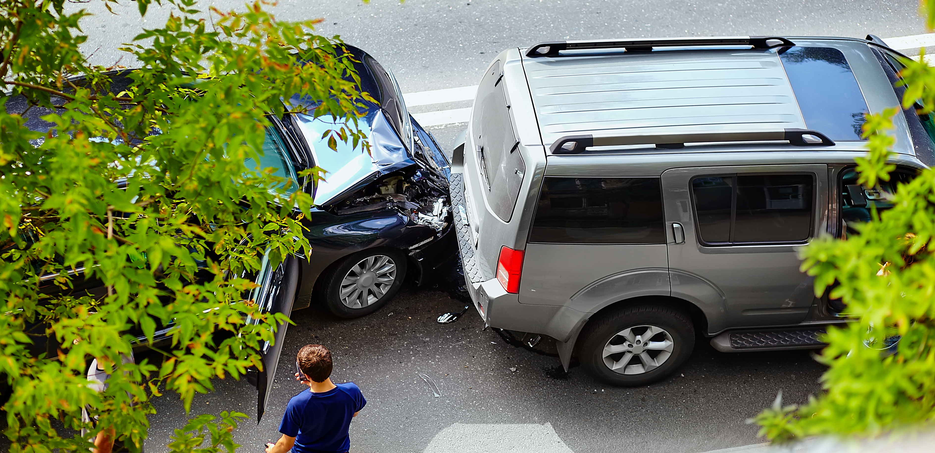
What? Likelihood? Severity?
Framework for proactive risk identification
In many cases, you already know the “what”
Notes:
Now that we covered a strategy for organizing our workload, let’s shift into a framework for identifying and analyzing risks.
Proactive risk management is about anticipating risks. Asking 3 critical questions will help with this: “What could happen?”, “How likely is it to happen?”, and “If it does happen, how severe are the consequences?” This is a framework for proactive risk identification.
Locations, drivers, property that make you say “I’m not surprised” could be good risks to start with for your analysis.
Based on State Risk claims data, at-fault vehicle accidents and property damage by water are the most frequent and expensive claims, so if you don’t already know the “what,” vehicle accidents or water damage are great places for you to start.

Slide 5
What? Likelihood? Severity?
How likely is the risk you identified, and how severe would the consequences be?
Certain | Low | Moderate | High | Extreme | Extreme
Likely | Low | Moderate | High | High | Extreme
Possible | Low | Moderate | Moderate | High | High
Unlikely | Low | Low | Moderate | Moderate | Moderate
Rare | Low | Low | Low | Low | Low
 | Insignificant | Minor | Significant | Major | Catastrophic
Likelihood
Severity
Notes:
Once you’ve identified the risk, using a risk matrix can help you analyze the likelihood of that risk and the severity of its consequences.
Vehicle accidents is a risk that many of our organizations are exposed to:
Helpful questions to ask are: How often are our employees driving? What types of vehicles are driven? What are the vehicles driven for? What general speeds are they driving?
These questions will help you determine the likelihood of a vehicle accident.
The next step is to determine the severity of a vehicle accident. Then, connect the two on this table and that will give you a general category for the level of risk.
Here is an example of using this matrix: comparing two types of risk exposures to vehicle accidents, LC consultants and UHP officers.
LC Consultants – driving multiple times a week to meet with clients; generally driving sedans; driving to and from meetings; driving at the posted speed limit.
Likelihood of an accident? Unlikely
Severity if a vehicle accident occurs? Minor
Risk level = “Low”
UHP officer – driving almost daily for multiple hours at a time; driving law enforcement vehicles; driving to enforce the law; driving at high speeds.
Likelihood of an accident? Possible/likely
Severity if a vehicle accident occurs? Major/catastrophic
Risk level = “High”/”Extreme”

Slide 6
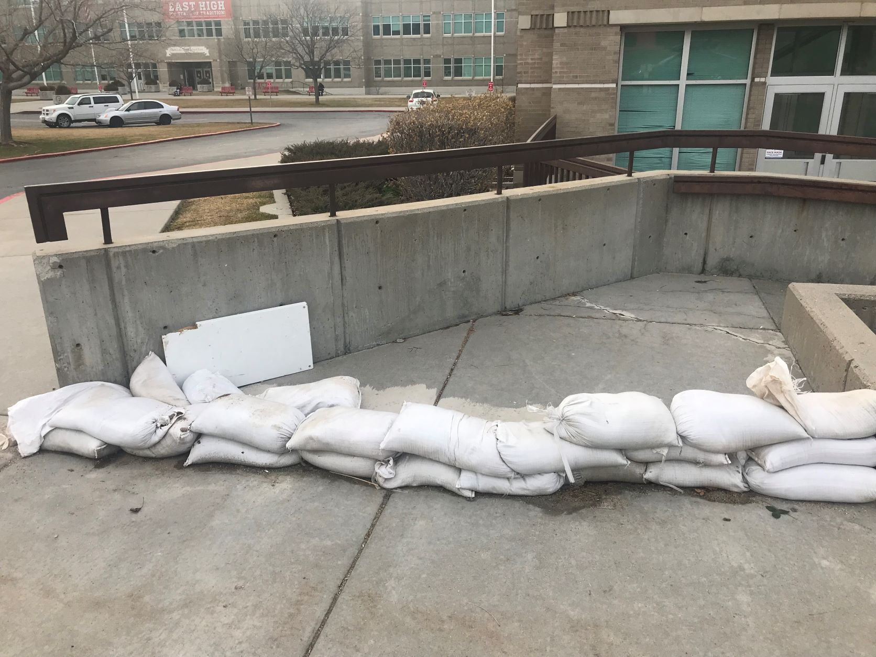
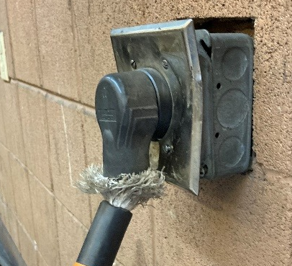
Risk Identification & Analysis
Safety is the top priority
Strategic framework
Notes:
Reminders:
Safety is the first priority.
These frameworks will help you be strategic in your work and to take action to keep everyone and state property safe.

Slide 7
We’re Here To Support You!
Del Brady
delbrady@utah.gov
Karen Peterson
karenpeterson@utah.gov
Ingrid Manning
imanning@utah.gov
Byungju Yoo
byoo@utah.gov
Ron Boshard
ronboshard@utah.gov
Wesley Whittington
wwhittington@utah.gov
Michelle Beus
mcbeus@utah.gov
Ed Rappleye
erappleye@utah.gov
https://risk.utah.gov/tools-resources/
Utah Department of Government Operations
Division of Risk Management
Notes:
DRM loss control team is available for assistance in all these areas. Contact us.
DRM website has a lot of informational resources and training.
Stay tuned for next month’s webinar, part 2 of this series: Risk Mitigation & Risk Tolerance

