Slide 1
Distracted Driving
Cerena Withers, CPM
Claim Adjuster
State of Utah
Division of Risk Management

Slide 2
Driven to Distraction
When you're behind the wheel, your only job is to drive!

Slide 3
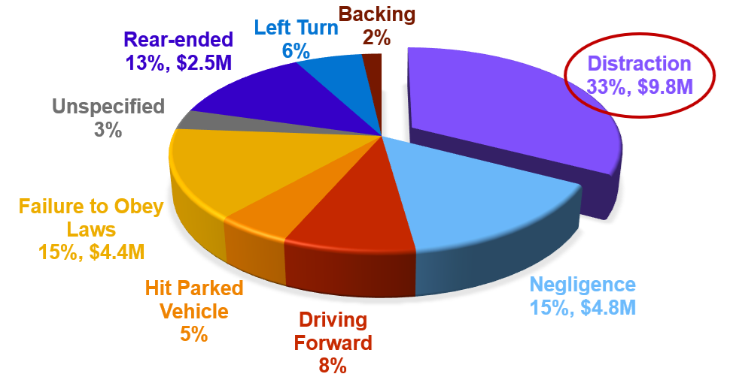
Preventable Losses
$9.8M Distracted Driving Claims
Claims between 2018 and 2024.

Slide 4
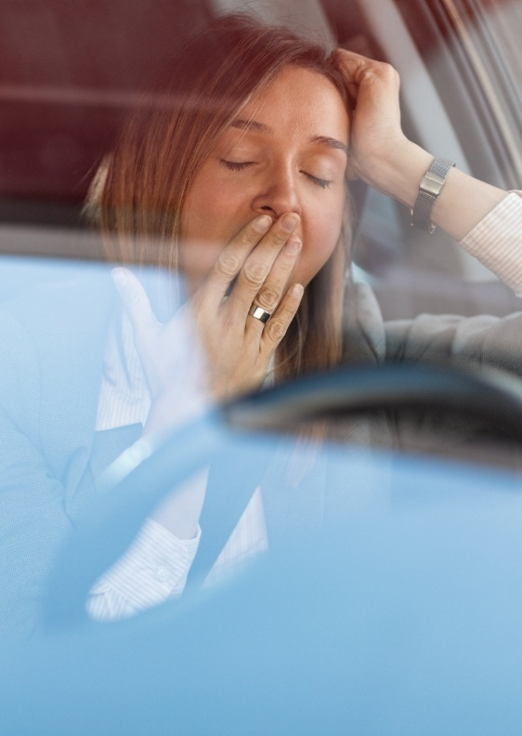
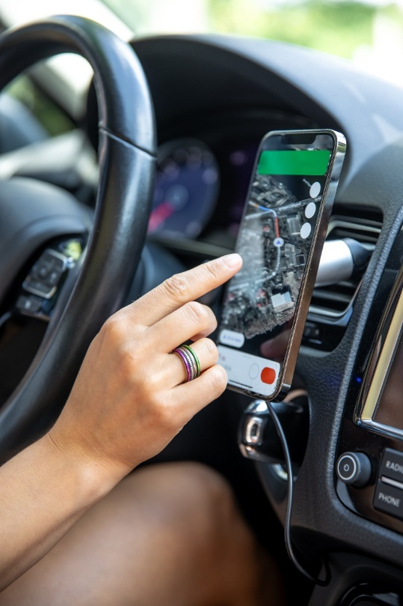

What are distractions?
Electronic & Technology
Personal Activities
Human Factors

Slide 5
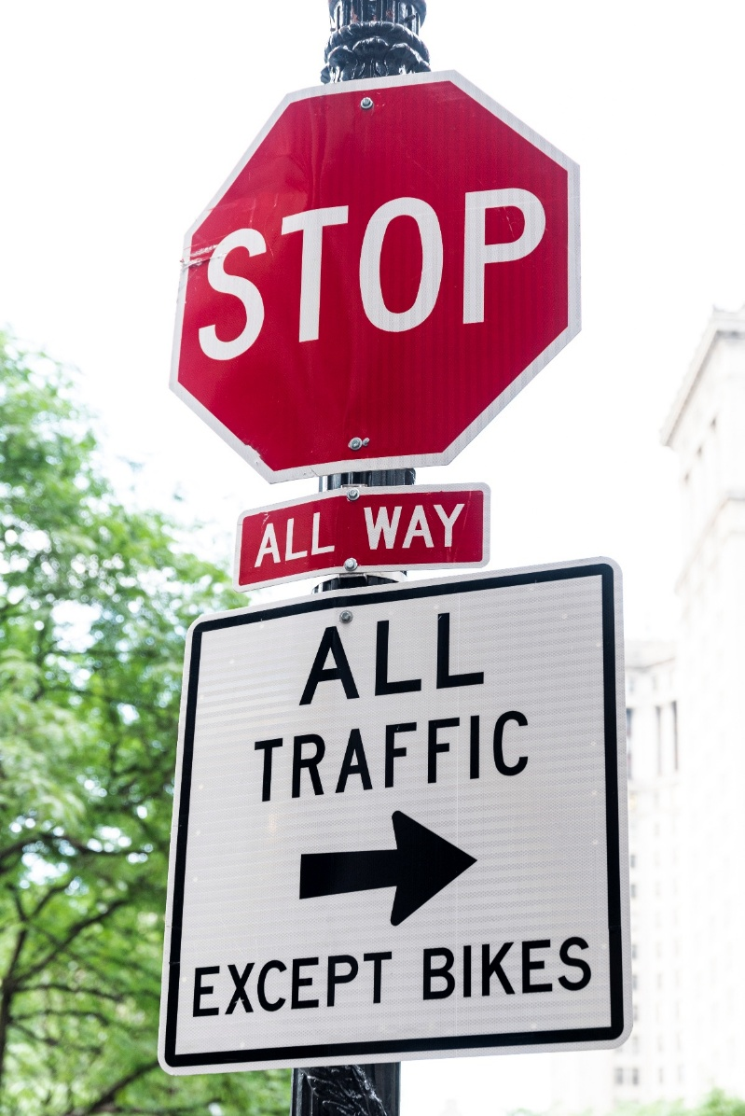
Distractions are anything that take your mind from the road and driving!

Slide 6
10%
Paying attention to the road
90%
Thinking or doing something else;
texting, day-dreaming, reaching for object, smoking, looking at billboards, etc.
Distracted Driving is now a secondary offense in the State of Utah.

Slide 7
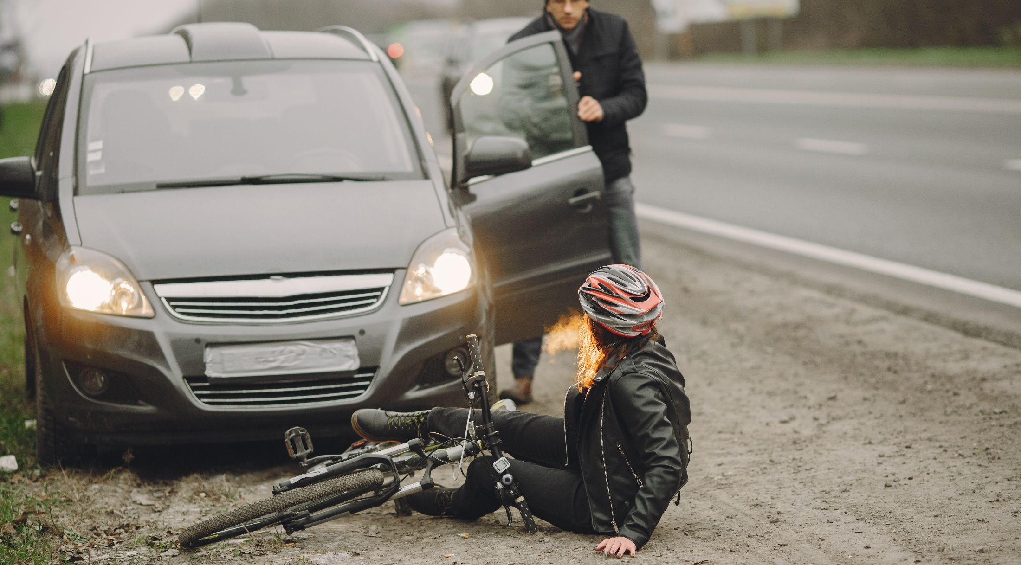

Playing the Odds

Slide 8

I only looked away for a second.

Slide 9
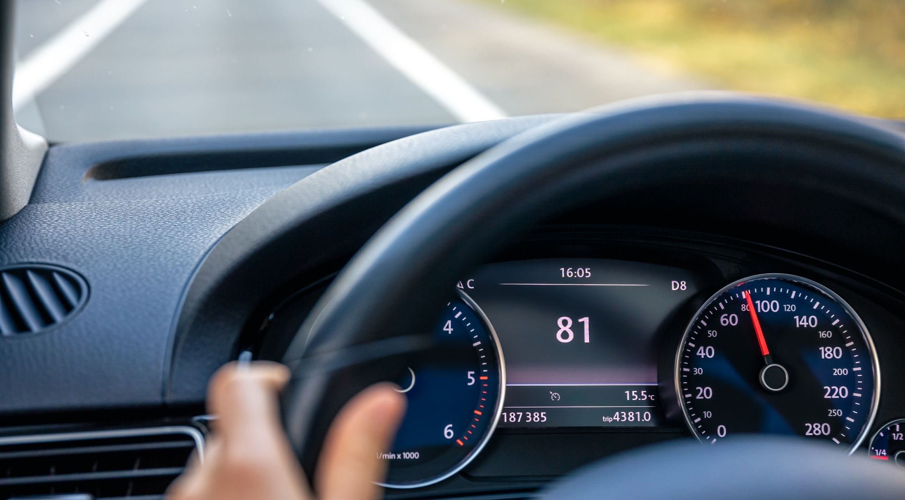
I am an experienced driver.

Slide 10
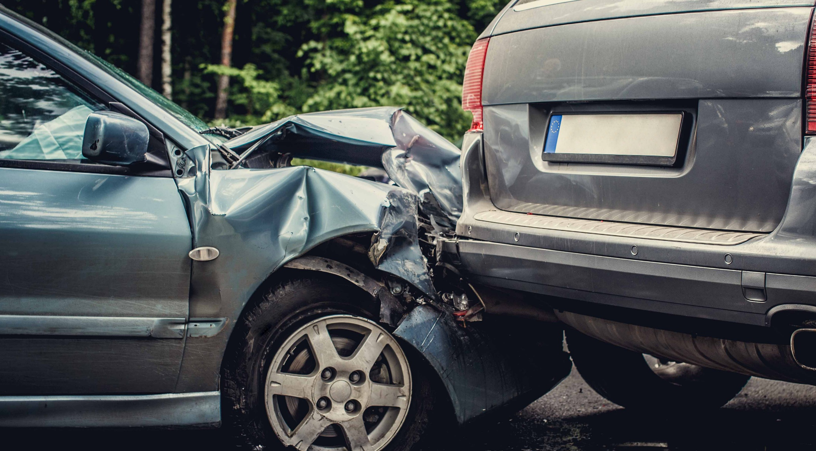
I was just unlucky.

Slide 11

I can multi-task.

Slide 12

It’s safe to use my phone at stop lights.

Slide 13
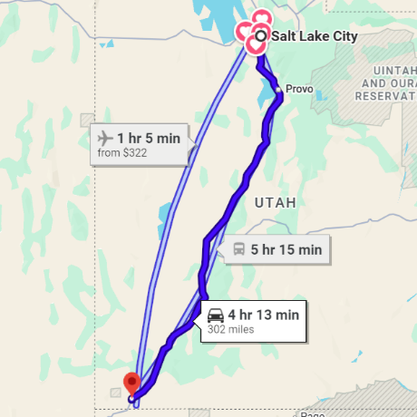
Every 2 miles…
400 Observations
Visual inputs like signs, other cars, and road conditions.
40 Decisions
Actions based on those observations, such as speed adjustments or signaling.
1 Mistake
Errors like failing to signal or misjudging a gap.
0.6 Near-Collision
When you drive from Salt Lake City to St. George.

Slide 14









Buckle up
Roadmap
for
Safe Driving
Scan mirrors every 3-5 seconds
Hands on the wheel
No eating or drinking
Preset climate control
Monitor traffic condition
Never text
Keep distance:
3-second rule

Slide 15
Stop distracted driving, before it stops you!

Slide 16
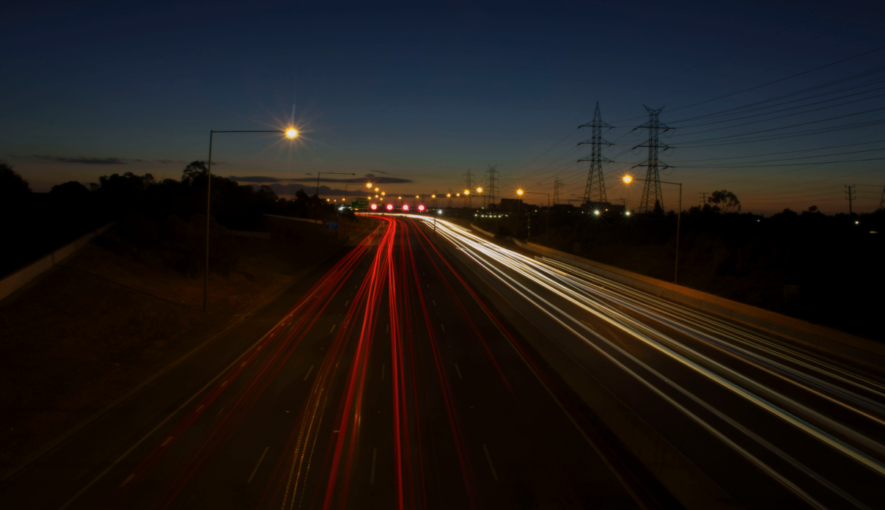
Driving Challenge
Commentary Driving:
Turn off your radio and cell phone
Roll your window down 2 inches
Adjust your mirrors and seats
Talk out loud to yourself about your driving
Driving Challenge

Slide 17
Cerena Withers
385-831-3314
cerenawithers@utah.gov

